Slide 1
GenCyber Networking and the Internet
An Introduction to Networking and the Internet

Slide 2
What is Networking?

Slide 3

What is Networking?
A standard for sending and receiving information
Early postal routes were ‘networked’
Also applies to computer systems
Able to send, receive, and process information, or ‘packets’

Slide 4
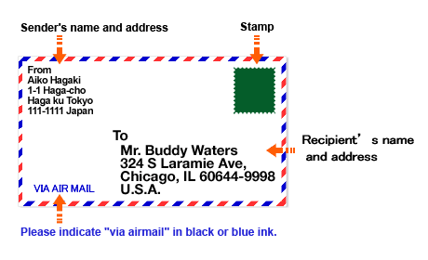
What is Networking?
Postal service ‘protocol’ is standardized
Letters must be formatted correctly
Computer networks also have protocols
Don’t follow protocol, can’t send data

Slide 5

What is Networking?
You’ll learn about:
Devices at Home
Wide Internet
Protocols
Packet Passing Exercises
Lab Exercise

Slide 6
Devices at Home

Slide 7
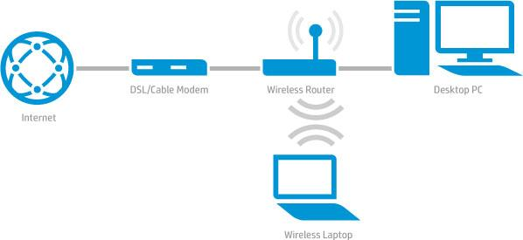
Devices at Home:
Basic Home Network
Diagram is basic breakdown
Most work done by ‘Wireless Router’
Same systems at school
Just separate devices, not all-in-one

Slide 8
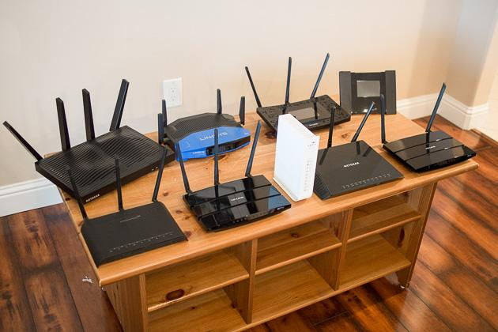
Devices at Home
Home Router
Collection of many devices
WAP
Router
Switch
Firewall
Sometime Modem

Slide 9

Devices at Home
Postal Example
You could find where the letter goes, buy a car, and deliver it yourself
Good for simple and small number of messages
If a lot needs to be send, better to use dedicated devices

Slide 10
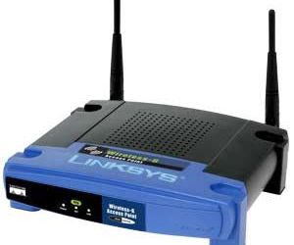
Devices at Home:
WAP
Wireless access point
Allows network connectivity using radio waves
Devices don’t have to have an ethernet card, only wifi chip
Network connected devices can be smaller
Included in most home devices

Slide 11
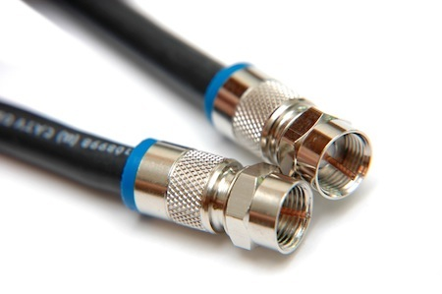
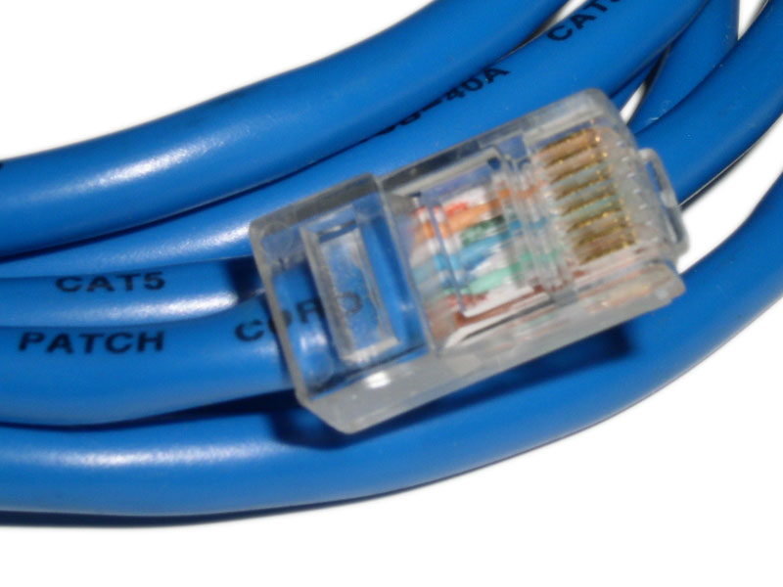
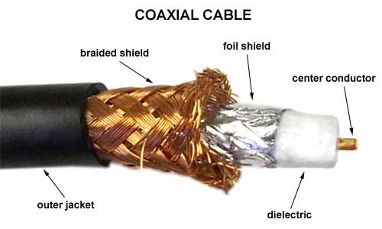
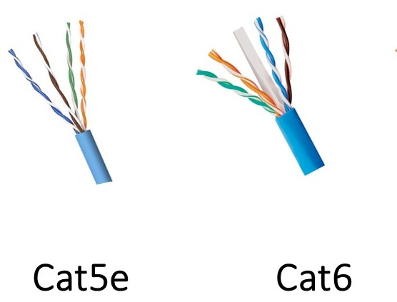
Devices at Home: Network Cables
Physically connects network devices
More reliable than wifi, but expensive and cumbersome
Full duplex communication
Cat Series Cable (ethernet)
Coaxial Cable (coax)
Optical Fiber Cable

Slide 12

Devices at Home:
Postal Example
Relating to postage example
Wireless is throwing your letter
May work, slower, unreliable, but convenient
Handing letter is wired
Inconvenient, faster, reliable

Slide 13
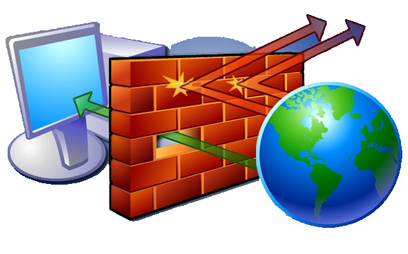
Devices at Home: Firewall
Use to allow or deny network traffic based on rules
Prevents hackers from hacking your stuff
Can be done with hardware or software
Hardware is fast/expensive, software is slow/cheap
Built into most commercial home devices

Slide 14
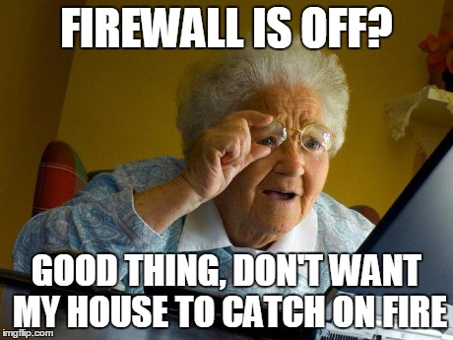
Devices at Home:
Postal Example
Firewall is the same as looking at the mail by hand
If you want it, you open and keep it
If you don’t want it, your throw it away or ‘drop’ the packet

Slide 15
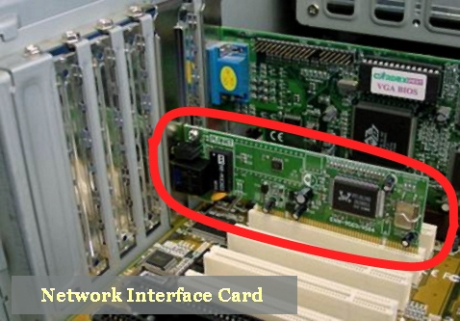
Devices at Home:
NIC
Network interface card
Allows a device to communicate with a network
Able to be done with USB, but slower
Wired or wireless
Many laptops have two
Computer can have more than one

Slide 16
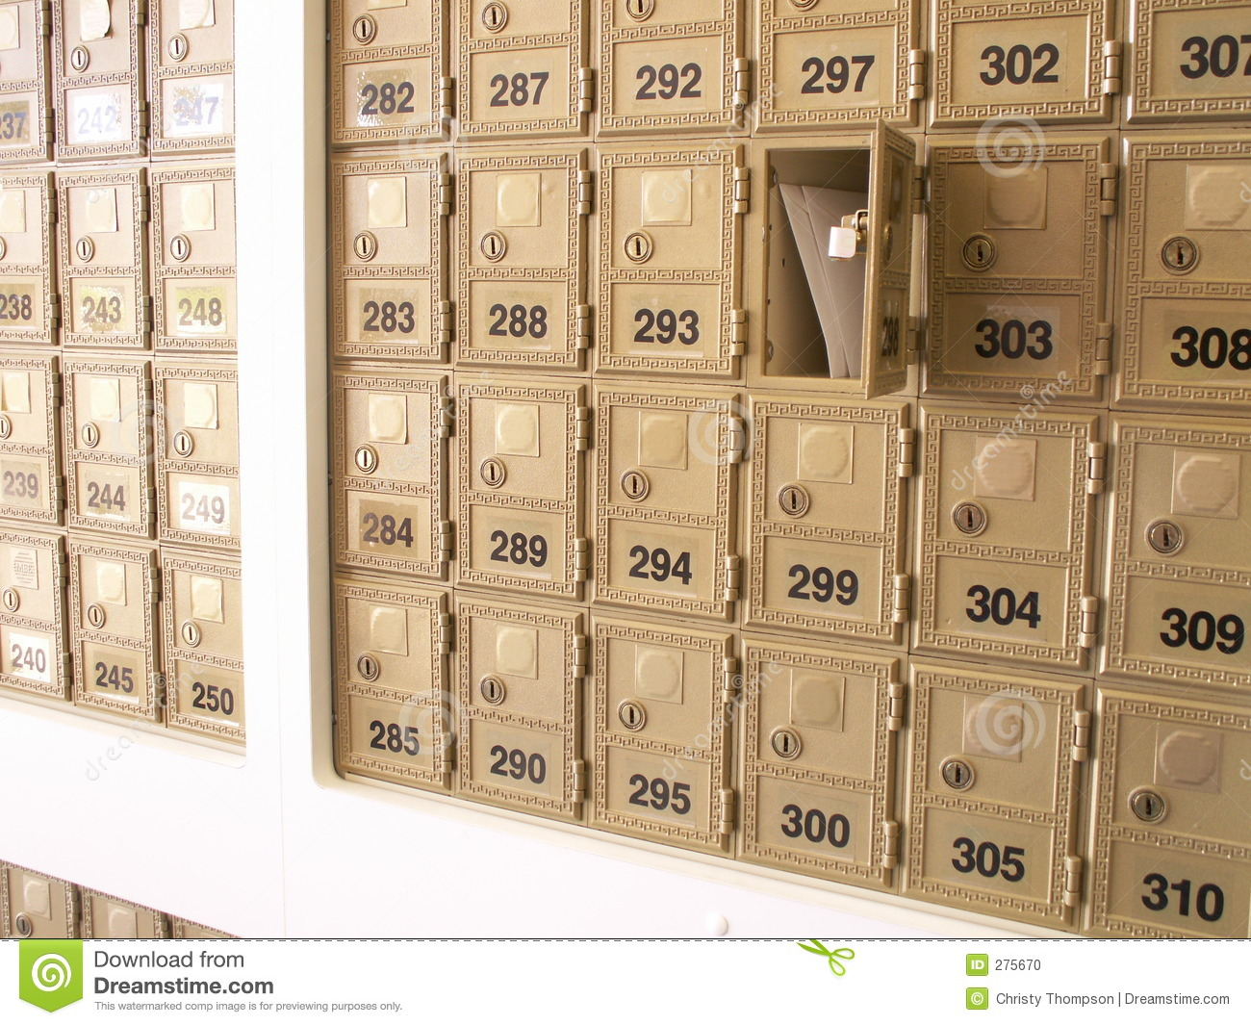
Devices at Home:
Postal Example
A mailbox allows you to send letter
Many people at home might need to send letter, but only one mailbox available
Able to send letters without it, but harder or need to use unique method

Slide 17
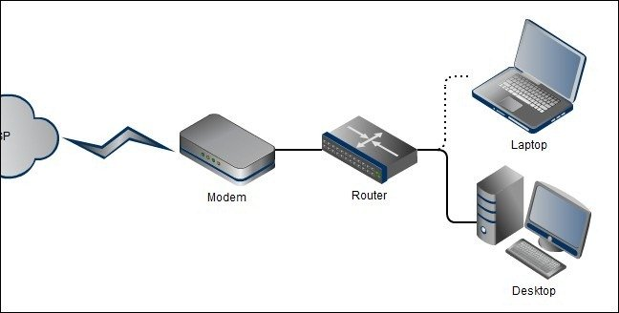
Devices at Home: Network Router
Routes network traffic
Routers are on the edge, switches are internal
Harward is fast/expensive
Software is slow/cheap
Dedicated devices
Built into most home wifi routers
Recursive, if it doesn’t know a route, it’ll ask another device

Slide 18

Devices at Home: Postal Example
A contacts book acts as a router
You don’t know someone's address, so you check your contact book
If you don’t have it, you ask a friend

Slide 19
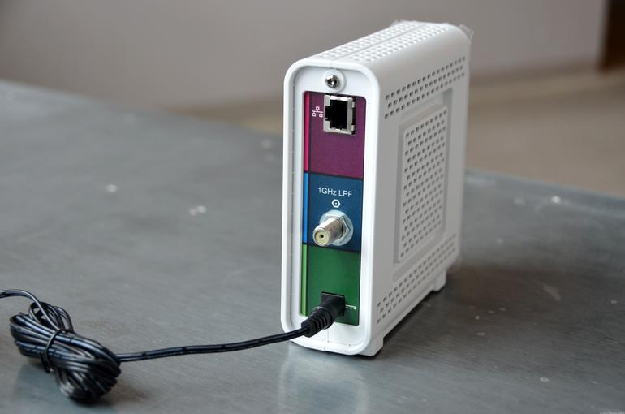
Devices at Home: Modem
Modulator-Demodulator
Turns digital computer signal to analog cable/phone signal
Required when using internet provider infrastructure
Not needed when network is connected directly using only ethernet
Sometimes integrated into home router

Slide 20

Devices at Home: Pen or Pencil
In you mind you know the address
Pen or pencil allows you to transfer thoughts to letter
Letter contains thoughts in ink and can be read by everyone
Transfers data from one form to another

Slide 21
Check on Learning

Slide 22
Devices at Home Questions
What does a router do?
A networking device that routes traffic
A networking device that switches internal traffic
A computer system that hosts web pages
Google’s special sauce

Slide 23
Devices at Home Questions
What does a firewall do?
Reroute network traffic to the server
Encrypts outgoing network traffic
Block network traffic based on rules
Keeps your network traffic lit fam 👌🔥🔥🔥

Slide 24
Devices at Home Questions
What is a NIC?
Not Inside Cuba
New Internal Cubical
Nice Ice Cream
Network Interface Card

Slide 25
Devices at Home Questions
How is a switch different from a router
You can turn it off and on with a switch
A switch routes internal traffic, a router external
When it’s lit, it does the splits
It can turn up instantly

Slide 26
Devices at Home Answers
What is a router?
A networking device that routes traffic
What does a firewall do?
Blocks traffic based on rules
What is a NIC?
Network Interface Card
How is a switch different from a router?
A switch routes internal traffic, a router external

Slide 27
The World Wide Web

Slide 28

The World Wide Web
Computer are cool, but better when connected
World wide network of computers
Allows the sharing of critical news and information
Better, share dank af memes

Slide 29

The World Wide Web
What you’ll learn:
Basics of how devices communicate
How programs and applications send information

Slide 30
The Wide Internet

Slide 31
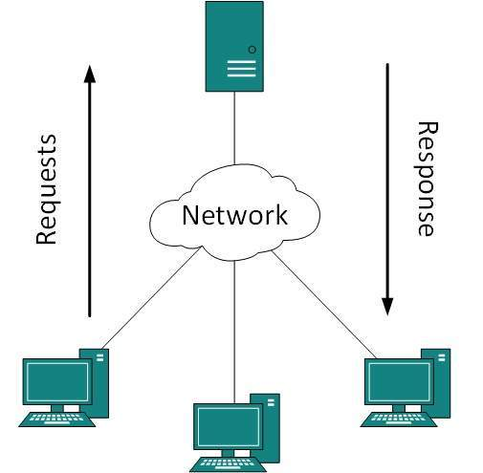
The Wide Internet: Websites & Browsers
Client-server model
Client is web browser, like you compter
Server is website, a computer in the cloud
Client request page from server
Server ‘serves’ it to the client

Slide 32

The Wide Internet: Postal Example
Magazine subscriptions are like websites
You request a magazine from a company by sending a message
They reply with a magazine for you to read
Same as requesting a web page and viewing it when received

Slide 33
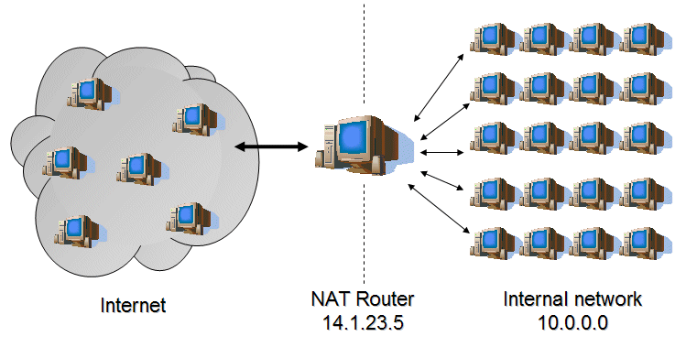
The Wide Internet: Network Address Translation
Allows one IP address for many people
Able to have multiple devices at home but only pay for one address
Regular people don’t need an address for everything
Slowed down IPv4 exhaustion
Will be gone when IPv6 is common

Slide 34

The Wide Internet:
URL
Uniform Resource Indicator
Text representation of a website
Hard to remember 192.168.0.94
Resolved by DNS to an IP address

Slide 35
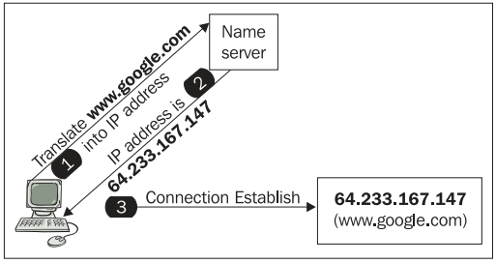
The Wide Internet:
DNS
Resolves URL/URI to an IP address
Local hosts file maps URL -> IP and negates DNS
False addresses can be given
Most sites are brought down by removing DNS record from a DNS server
Multiple DNS servers allows for redundancy
Notes:
Humans are bad at remembering things, URL’s give meaning to a meaningless number.
URL’s are useless for routing packets, there must be a way to translate URL’s into usable IP address.
An entire system is built just for this called DNS.
Back when there were very few computers on the internet and DNS was not needed or invented, the hosts file was used.
Hosts file allows user to map ip address to a meaningful name, usually the name of the machine aka hostname.
Eventually hosts files became large and annoying to work with and DNS was born.
To get the ip address of a url do:
~$ nslookup <happy-website url>
Map the ipv4 or ipv6 address to a different-website URL in the hosts file.
In a browser go to different-website URL, and see that it now goes to happy-website.
~tada~
If wireshark is open while doing the above, note that there is no DNS resolution for different-website.
Hosts file locations:
Windows: C:\Windows\System32\drivers\etc\hosts
Linux: /etc/hosts

Slide 36
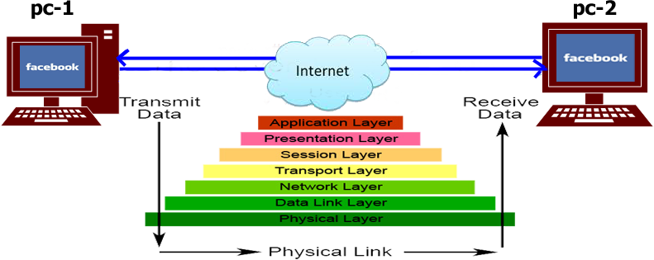
The Wide Internet: OSI Layer Model
Open Systems Interconnection Model
Conceptualization of how packets move through a system
Data is sent down and received up
Like mailing a letter, you write name, put in envelope, post man reads envelope, receiver opens and reads message

Slide 37
The Wide Internet: TCP/IP
Open Systems Interconnection Model
Conceptualization of how packets move through a system
Data is sent down and received up
Like mailing a letter, you write name, put in envelope, post man reads envelope, receiver opens and reads message

Slide 38
Note Passing Exercise

Slide 39

Exercise:
Partner up
Write message on paper, fold up and write receiver
Give to partner
Only open if directed to them
Receiver opens note to read message
Same as OSI model by reading and removing headers till actual data is received

Slide 40
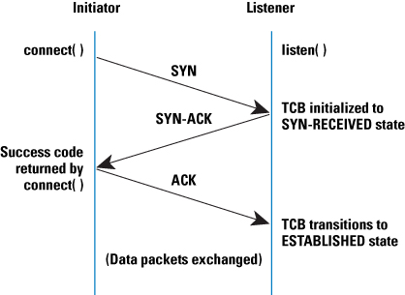
Internet: TCP Handshake
Stream based protocol
Able to resolve corrupt packets
Used when data integrity is important
Connection negotiation and establishment
Also has a tear down process

Slide 41
SYN-ACK Exercise

Slide 42

Exercise:
Partner up
One extends hand first as SNY
Other extends hand as ACK
Shake hands to complete SYN-ACK
One extend hand first as FIN
Other extends hand as FIN-ACK
Shake hands to to say goodbye ACK

Slide 43
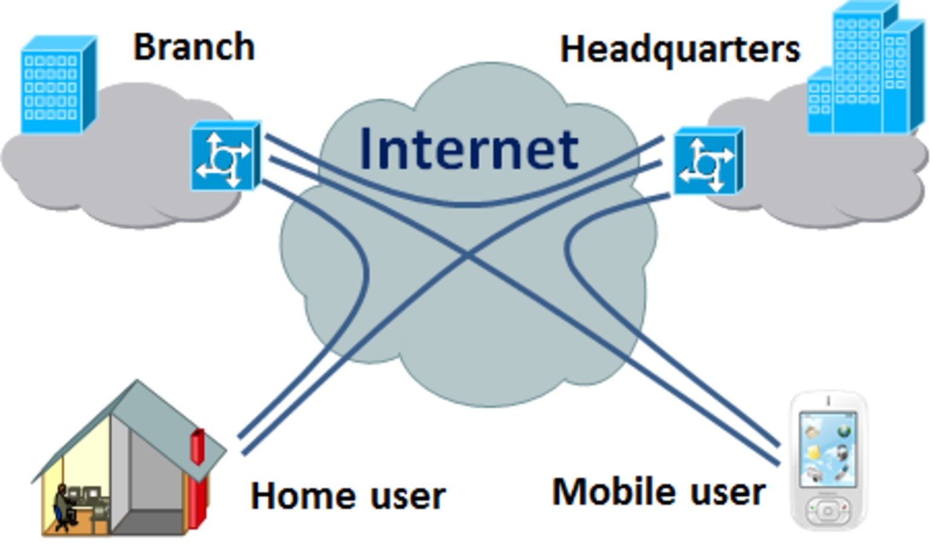
Internet: Private Networks
Any network that can’t be accessed from the open internet
Many networks behind a firewall for security
Able to have a private network over the wide internet
Home, office, or business networks

Slide 44
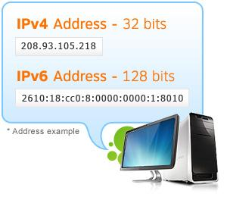
Internet: IPv4 & IPV6
IPv4 limited number of addresses
Address the problem of addresses running out
NAT slowed down problem
IPv6 allows for more addresses
Permanent solution

Slide 45
Packet Passing Exercise

Slide 46
Protocols

Slide 47
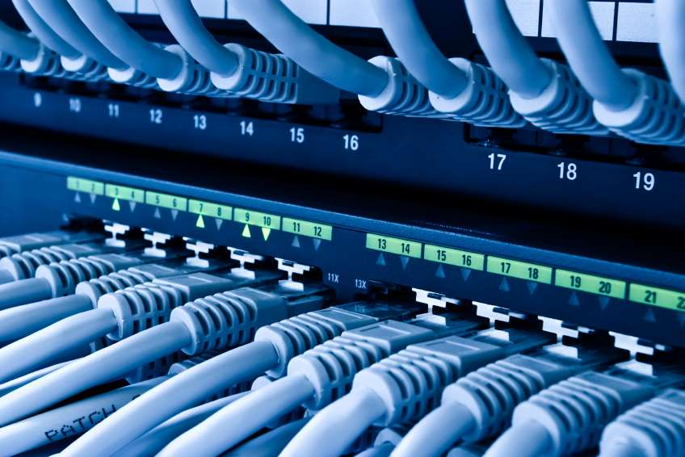
Protocols: Ports
Used for devices to communicate
Different from ethernet port i.e. network interfaces
20 FTP
22 SSH
23 Telnet
25 SMTP
53 DNS
80 HTTP

Slide 48
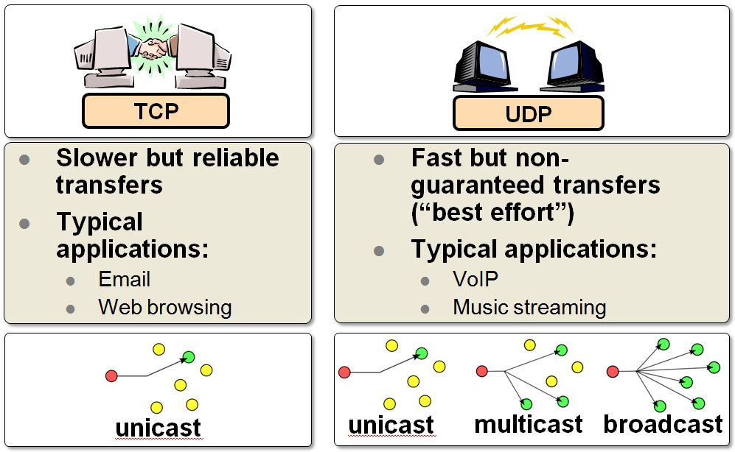
Protocols: TCP & UDP
Transmission Control Protocol
User Datagram Protocol
TCP is reliable, used when data integrity is critical like banking or social media
UDP is fast, when latency is an issue, like gaming or videos

Slide 49

Protocols: Telnet
Allows for remote control of a computer system
Old way for computers to communicate
Non secure and sent in the clear
Used for intranet remote system management

Slide 50
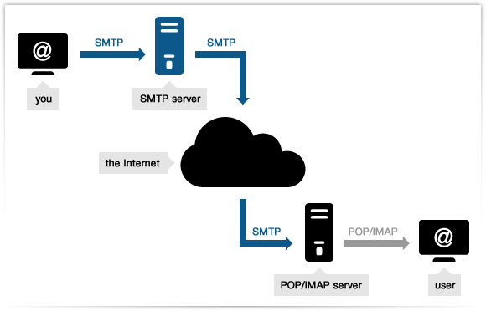
Protocols: SMTP and POP
Simple Mail Transport Protocol
Post Office Protocol
Emails are sent via SMTP
Email are read via POP using a mail client

Slide 51
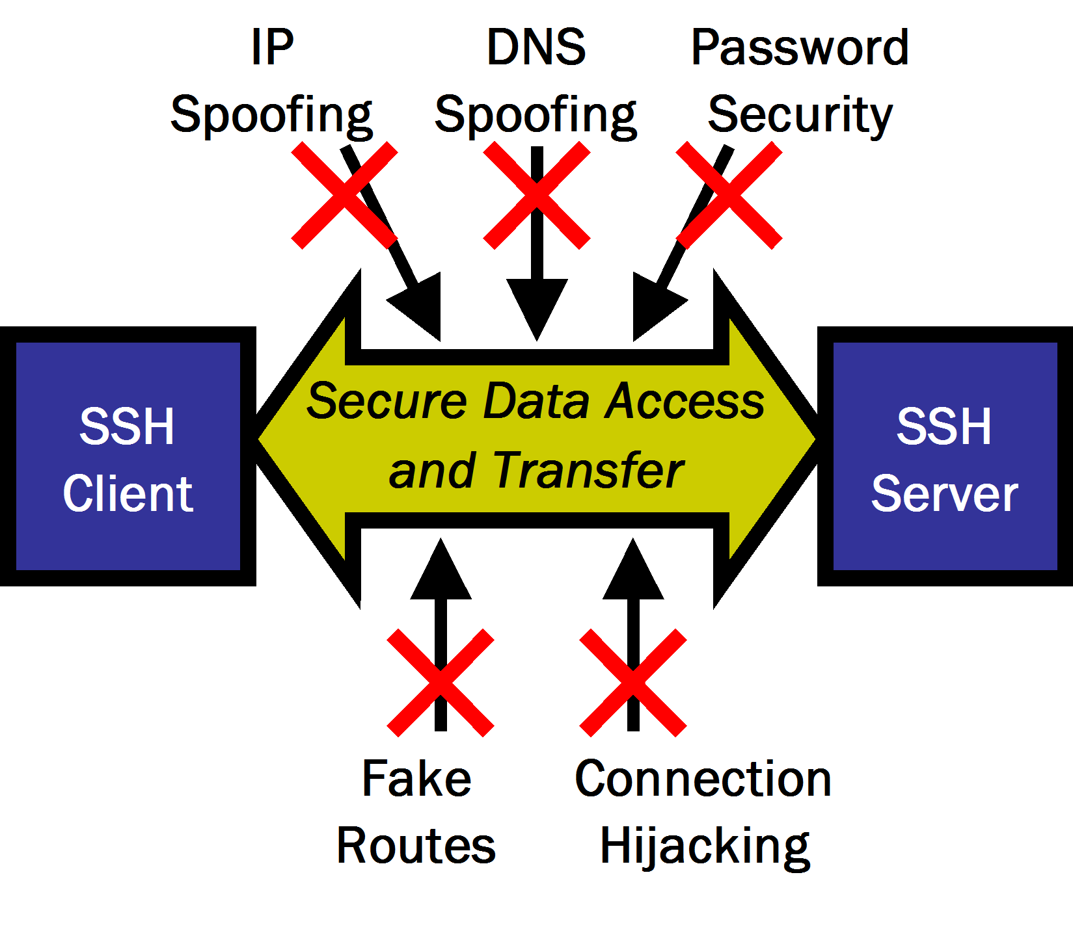
Protocols: SSH
Used to remotely access systems
More secure than telnet
Encrypts traffic
Prevents traffic from being snooped
Secure enough to use on unsecure networks

Slide 52
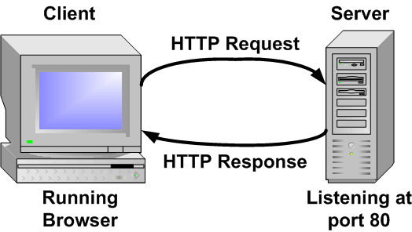
Protocols: HTTP(S)
HyperText Transfer Protocol
Needs to be reliable
Works on top of TCP
Used to send webpages
Done after server address has been resolved via DNS qurey
Can be secured if information is important i.e. banking using HTTPS

Slide 53
Sources
ieee.org
learn-networking.com
packetpushers.net
packetlife.net
reddit.com/r/networking
wikipedia.org

Slide 54
Lab Activity

